Slide 1


Capstone Project #2
SIC – AI701
Notes:
Note:
1

Slide 2
Agenda
  Team Members
  Project Summary and Problem Statement
  Data cleaning & Preprocessing
  Exploratory Data Analysis
  Machine Learning Model & Evaluation
  Conclusion, Recommendations, & Future Work
Samsung Innovation Campus

Slide 3
Team Members
  Mostafa Ahmed
  Mohamed Adel
  Omar Abdelrazek
Samsung Innovation Campus

Slide 4
Project Summary and Problem Statement
Samsung Innovation Campus
Notes:
Note:
2

Slide 5

Project Summary
In this project, we tried to apply what we leaned in the past few weeks on a real-world dataset
Our dataset is about Airline Passenger Satisfaction
We aim at exploring this dataset, asking the right business questions, applying ML model to it in order to help us find useful insights for potential improvement in the Airline System
Samsung Innovation Campus

Slide 6
Dataset Description
  We got our dataset from Kaggle, available here
  Its size is around 100k records and 24 features
  Some of these features are based on the passenger’s feedback
  It contains several features like:
    Gender
    Customer Loyalty
    Type of Travel
    Satisfaction (our target in ML model)
    Class
    And more…
Samsung Innovation Campus

Slide 7
Data Cleaning & Preprocessing
Samsung Innovation Campus
Notes:
Note:
2

Slide 8
Data Cleaning
  First, we tried to search for null values in all columns, we find only around 300 missing values in the ‘Arrival Delay in Minutes’ column.
  Instead of dropping them (being so small compared to the whole dataset), we filled them with the median of the column (median, not mean, in case of existing outliers)
  Second, we dropped the ‘Unnamed’, and ‘id’ columns, they have no effect on the rest of columns
  Third, we found many categorical columns that are int64 data type, we changed that to a suitable one for categorical values
Samsung Innovation Campus

Slide 9
Data Cleaning
  Fourth, we did label or one-hot encoding for categorical columns
  Sixth, we did scale the data in order to be suitable for the Machine Learning model
Samsung Innovation Campus

Slide 10
Exploratory Data Analysis
Samsung Innovation Campus
Notes:
Note:
2

Slide 11
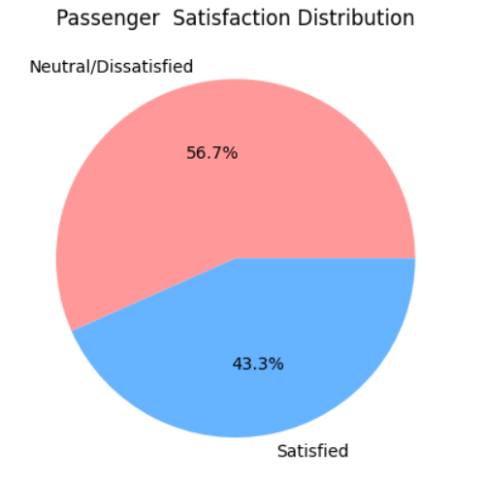
EDA
  As a basic business question, we tried to find the percentage of satisfied customers to the total, and we found they are only 43.3%
Samsung Innovation Campus

Slide 12
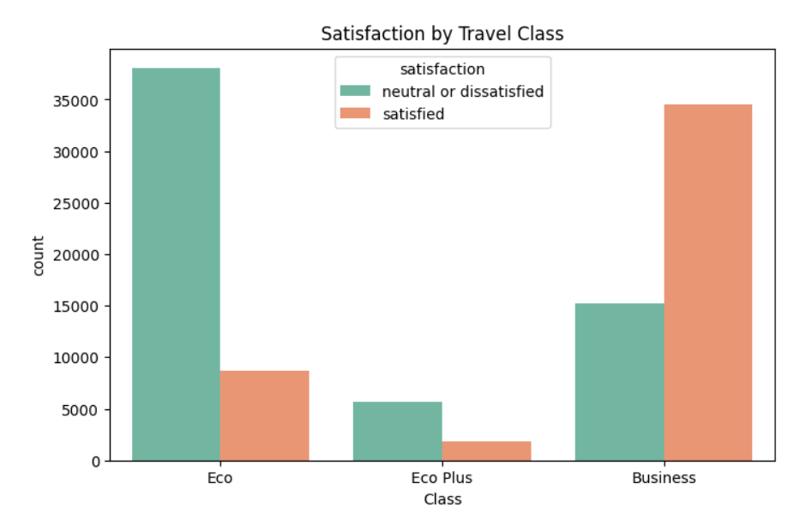
EDA
  We then asked the question, Does class affect passenger’s satisfaction? We found it to be True! As class gets higher as the satisfaction does
Samsung Innovation Campus

Slide 13
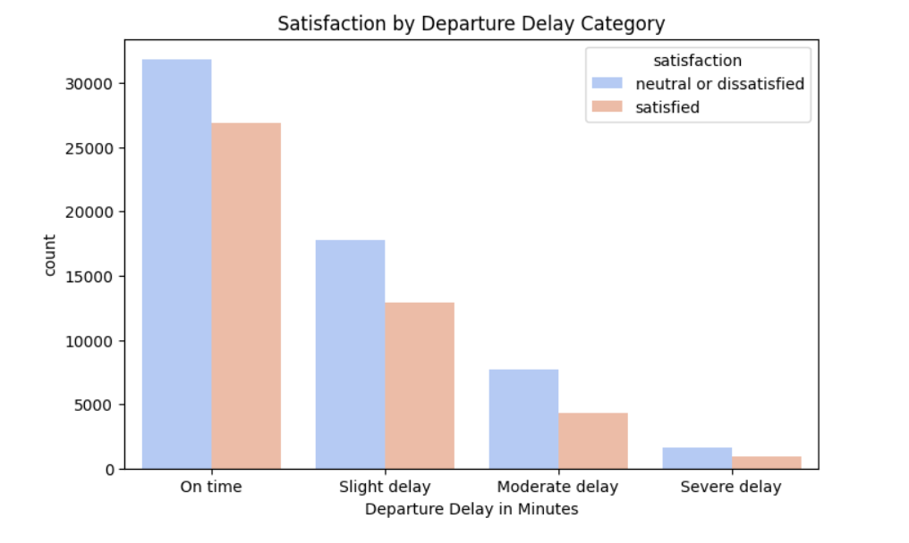
EDA
  What about Flight Delay? Nope, no effect (which is weird)
Samsung Innovation Campus

Slide 14
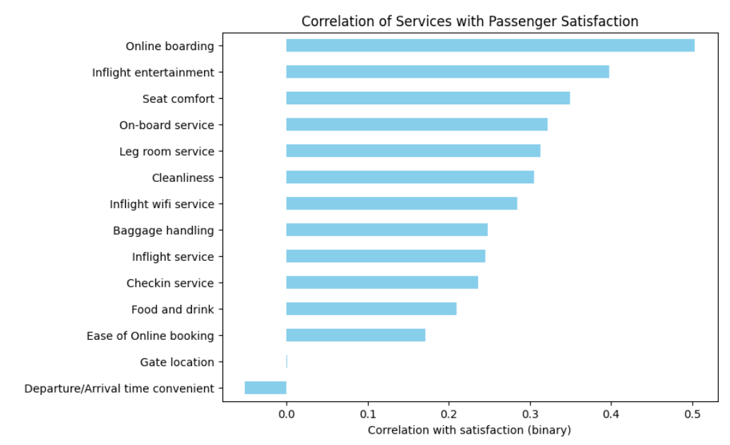
EDA
  Now comes an important question, which in-flight services most strongly correlate with satisfaction? We found that online boarding is the dominant factor.
Samsung Innovation Campus

Slide 15
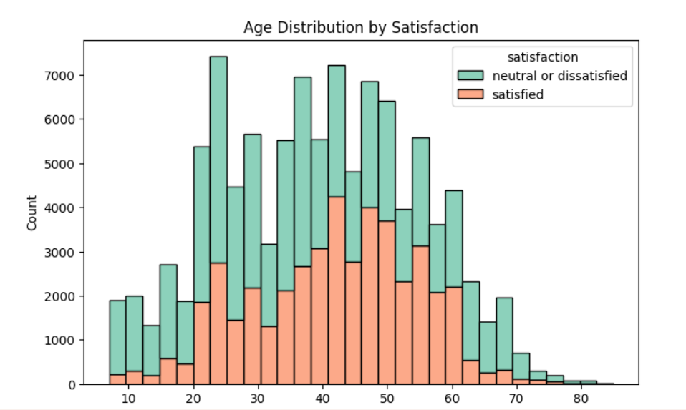
EDA
  Does Age affect satisfaction?
Samsung Innovation Campus

Slide 16
Machie Learning Model & Evaluation
Samsung Innovation Campus
Notes:
Note:
2

Slide 17
ML Model & Evaluation
  Our target column is ‘Satisfaction’
  Our problem is mainly a Classification problem
  We used Accuracy, Precision, recall, support and F1-Score as metrics for evaluating models
Samsung Innovation Campus

Slide 18
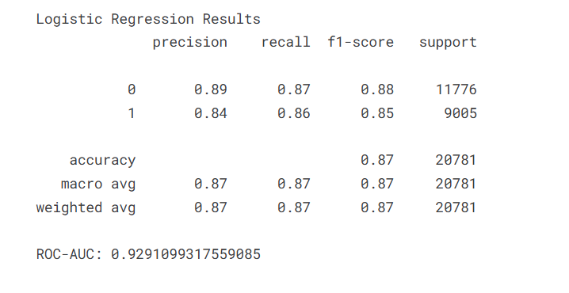
ML Model & Evaluation
  We first used Logistic Regression as our Baseline model, and it gave good results, however, not the best
Samsung Innovation Campus

Slide 19
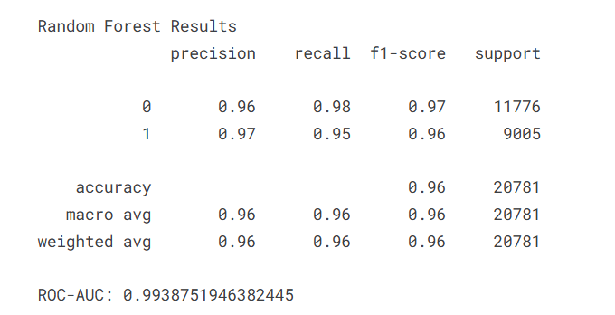
ML Model & Evaluation
  Then, we used Random Forest, it took so much time, but it gave really good results
Samsung Innovation Campus

Slide 20
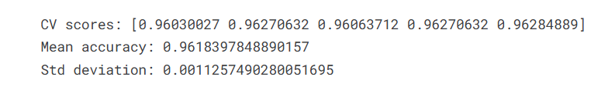
ML Model & Evaluation
  We then checked is the model (Random Forest) overfitting or not by using cross validation, and this proved to be wrong (no overfitting)
Samsung Innovation Campus

Slide 21
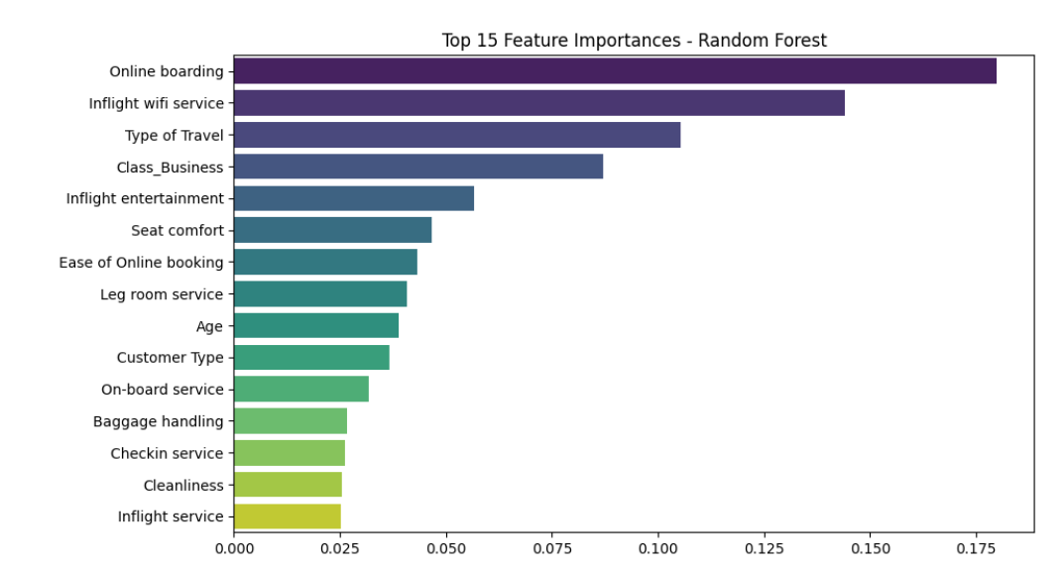
ML Model & Evaluation
  We asked Random Forest to give us the most important factors affecting passenger’s satisfaction, and ‘Online Boarding’ still the dominant
Samsung Innovation Campus

Slide 22
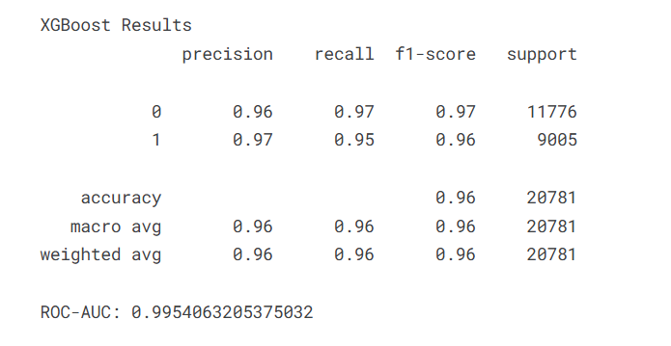
ML Model & Evaluation
  We tried other models, this one is XGBoost, and it gave very good results (comparable to Random Forest)
Samsung Innovation Campus

Slide 23
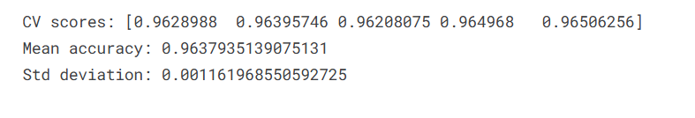
ML Model & Evaluation
  We checked overfitting again to this one using cross validation, and it is not overfitting
Samsung Innovation Campus

Slide 24
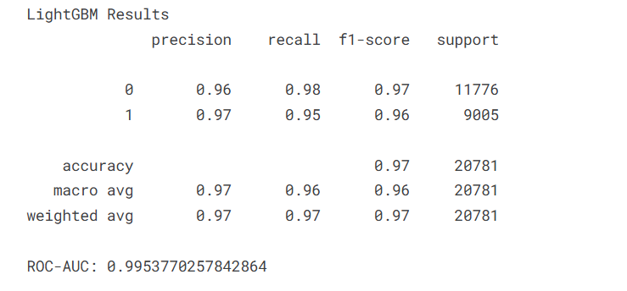
ML Model & Evaluation
  Our final model is LightBoost, this model gave results like Random Forest and XGBoost but it was much faster than both!
Samsung Innovation Campus

Slide 25
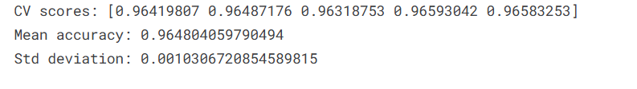
ML Model & Evaluation
  We checked overfitting here again, and it proved to be wrong
Samsung Innovation Campus

Slide 26
Conclusion, Recommendations and Future work
Samsung Innovation Campus
Notes:
Note:
2

Slide 27
Conclusion and Recommendations
  After doing EDA, we found that mainly the most important factor affecting customer’s satisfaction is the Online Boarding, so the Airline Company should invest more in it, by, for example:
    Offer discounts/loyalty points for using online check-in.
    Make mobile boarding passes easy to save and scan.
    Improve app stability (fix crashes, loading times).
    Faster boarding → fewer delays → cost savings for the airline.
Samsung Innovation Campus

Slide 28
Conclusion and Recommendations
  We also found that 57% of our customers are not satisfied, which indicates existing problems with the system that need fast action
  Some of these problem are already found like bad Online Boarding (as mentioned), not satisfying seat-comfort, and the inflight Wi-Fi service
Samsung Innovation Campus

Slide 29
Limitations
  After all, we managed to know whether our passengers are satisfied or not, and which factors affect their satisfaction, but still our approach is still limited due to the following reasons
    Columns are limited relatively ,there may be other factors that affect satisfaction, like bag weight, price of flights and the list goes on
    We don’t know the competitors’ data to compare to, other competitors in the same country may be doing worse or bad, so we don’t know
    We don’t know the business goals, so we can take better steps based on
Samsung Innovation Campus

Slide 30
Future Work
  Till now, we had a great amount of valuable learning, and we applied it by practice on a real-world dataset
  Our next steps is to get into more complex datasets that solve critical and important problems using both ML and DL
  We’re looking forward for more learning and more work
  Thank YOU!
Samsung Innovation Campus

Slide 31

ⓒ2020 SAMSUNG. All rights reserved.
Samsung Electronics Corporate Citizenship Office holds the copyright of book.
This book is a literary property protected by copyright law so reprint and reproduction without permission are prohibited.
To use this book other than the curriculum of Samsung innovation Campus or to use the entire or part of this book, you must receive written consent from copyright holder.
Notes:
14

